Slide 1
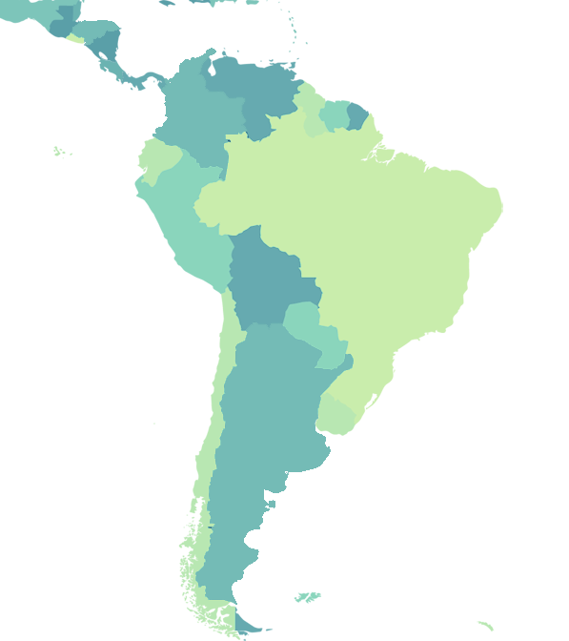
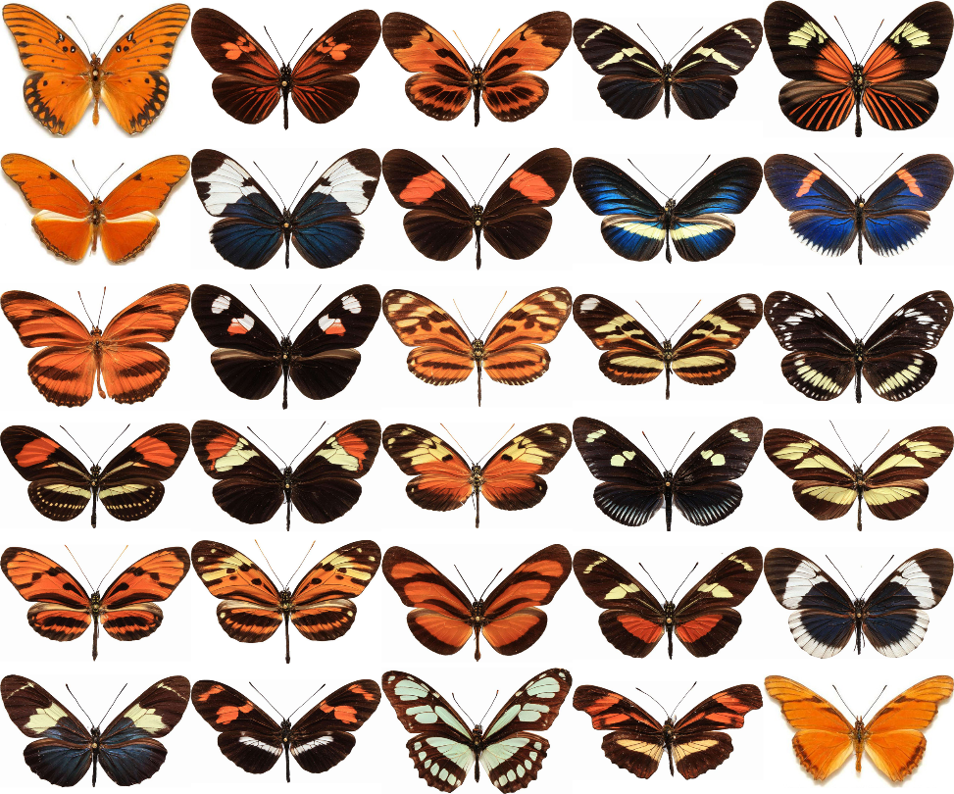

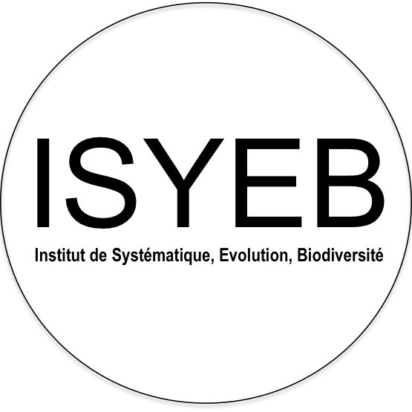


Müllerian mimicry in neotropical butterflies
“One force to shape them all,
and in the jungle bind them ”
Maël Doré
Eddie Perochon, Keith Willmott, Sébastien Lavergne, Nicolas Chazot, André VL Freitas, Colin Fontaine, Krzysztof Kozak, Neil Rosser, Marianne Elias
SFE² - GfÖ - EEF – 2022
Credit photos: C. Jiggings ; Credit figure: E. Pérochon

Slide 2
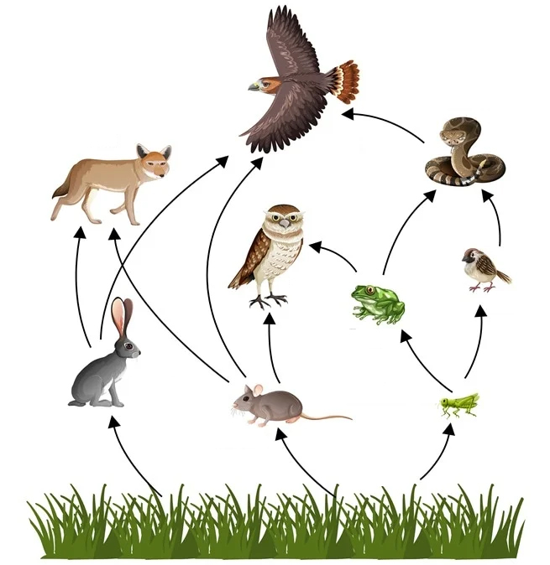
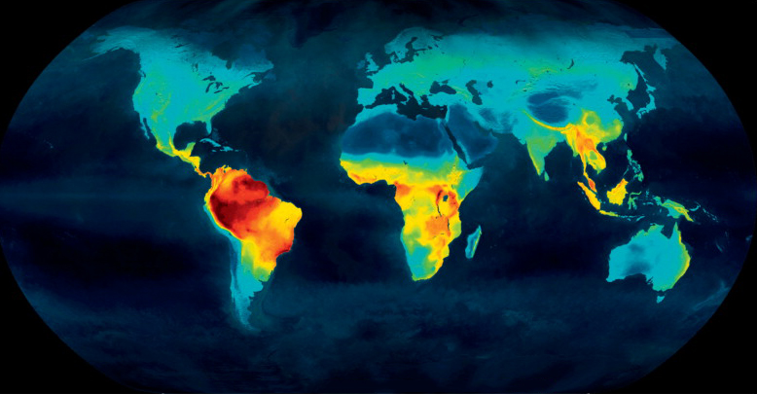
Context
Biodiversity
Biological units
Interactions
+
Mannion et al., 2014
Credit: Shutterstock.com
Maël Doré – SFE² - GfÖ - EEF – 2022
1

Slide 3


Context
/
/
Competition
Mutualism
Spatial pattern
Niche evolution
Maël Doré – SFE² - GfÖ - EEF – 2022
2

Slide 4


Context
/
/
Competition
Mutualism
Spatial pattern
Niche evolution
Maël Doré – SFE² - GfÖ - EEF – 2022
2

Slide 5
Context
/
/
Competition
Mutualism
Spatial pattern
Niche evolution
Maël Doré – SFE² - GfÖ - EEF – 2022
2

Slide 6
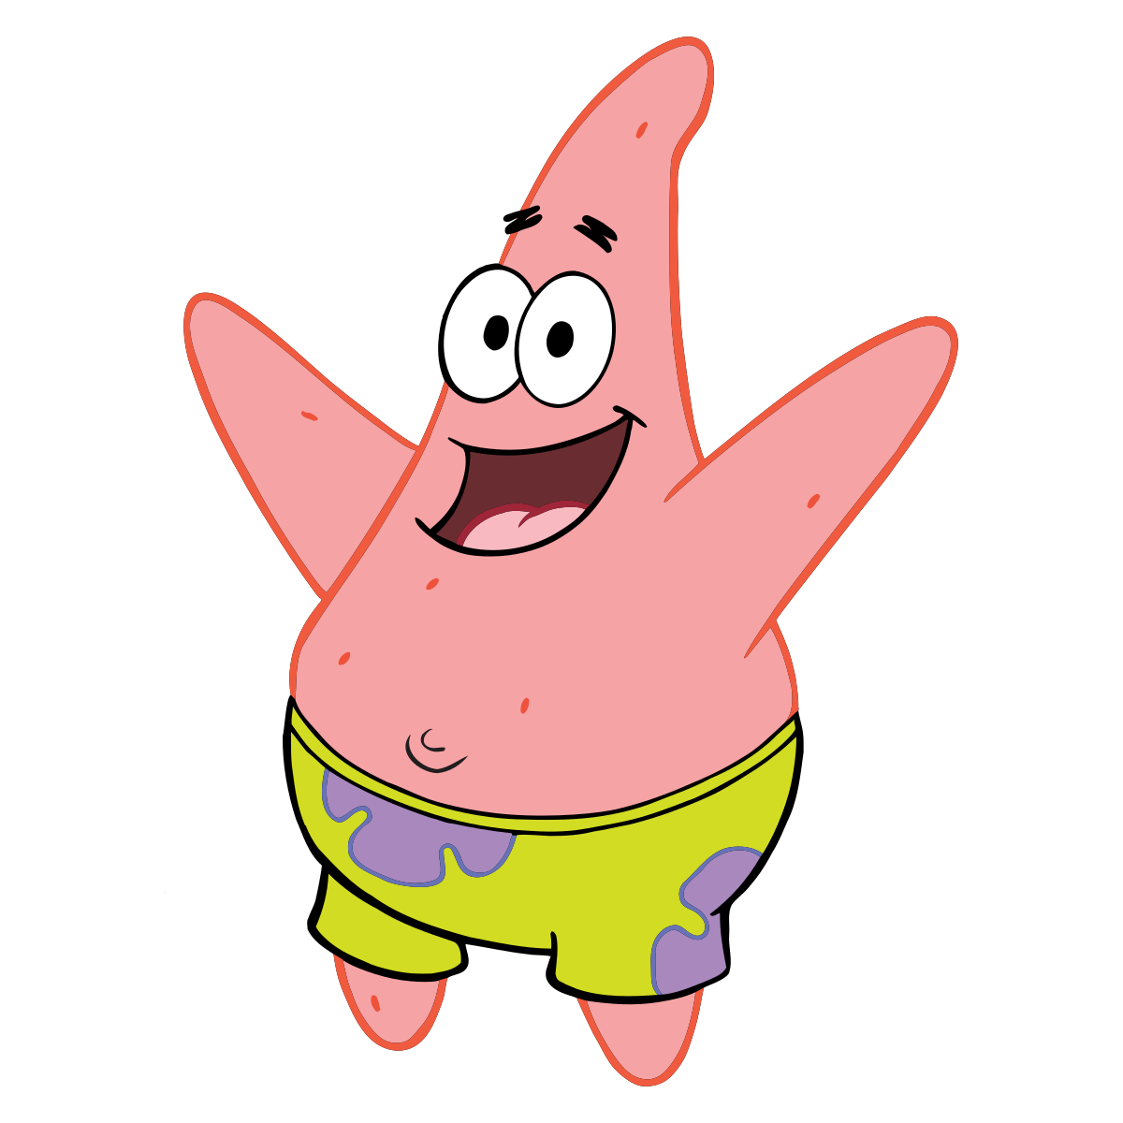
Context
/
/
Competition
Mutualism
Spatial pattern
Niche evolution
Maël Doré – SFE² - GfÖ - EEF – 2022
2

Slide 7
Context
/
/
Competition
Mutualism
Spatial pattern
Niche evolution
Maël Doré – SFE² - GfÖ - EEF – 2022
2

Slide 8
Questions & Hypotheses
Can mutualistic interactions outweigh the effects of competition at the macroecological scale?
Spatial pattern
Promote the large-scale cooccurrence of mutualistic species
Niche evolution
Drive the convergence of the niche of mutualistic species
Maël Doré – SFE² - GfÖ - EEF – 2022
3

Slide 9
Questions & Hypotheses
Can mutualistic interactions outweigh the effects of competition at the macroecological scale?
Spatial pattern
Promote the large-scale cooccurrence of mutualistic species
Niche evolution
Drive the convergence of the niche of mutualistic species
Maël Doré – SFE² - GfÖ - EEF – 2022
3

Slide 10
Questions & Hypotheses
Can mutualistic interactions outweigh the effects of competition at the macroecological scale?
Spatial pattern
Promote the large-scale cooccurrence of mutualistic species
Niche evolution
Drive the convergence of the niche of mutualistic species
Maël Doré – SFE² - GfÖ - EEF – 2022
3

Slide 11

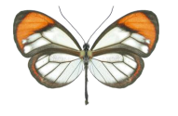
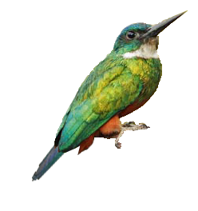
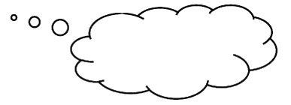



Study system: Müllerian mimicry
Aposematism: warning signals
Shared signals = mutualistic interactions
Positive frequency-dependent selection (Müller, 1879)
Consequences:
Convergence of local patterns (Sherratt, 2008)
Phenotypically similar species benefit from cooccurring
Macroecological scale?
Species distribution
Species niche evolution
=
=
???
Maël Doré – SFE² - GfÖ - EEF – 2022
4

Slide 12
Study system: Müllerian mimicry
Aposematism: warning signals
Shared signals = mutualistic interactions
Positive frequency-dependent selection (Müller, 1879)
Consequences:
Convergence of local patterns
Phenotypically similar species benefit from cooccurring
Macroecological scale?
Species distribution
Species niche evolution
=
=
???
Maël Doré – SFE² - GfÖ - EEF – 2022
4

Slide 13
Study system: Müllerian mimicry
Aposematism: warning signals
Shared signals = mutualistic interactions
Positive frequency-dependent selection (Müller, 1879)
Consequences:
Convergence of local patterns
Phenotypically similar species benefit from cooccurring
Macroecological scale?
Species distribution
Species niche evolution
=
=
???
Maël Doré – SFE² - GfÖ - EEF – 2022
4

Slide 14

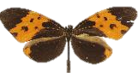



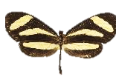


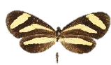


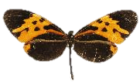






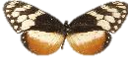

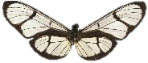


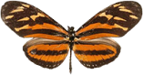

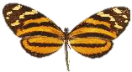
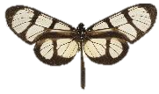


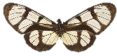




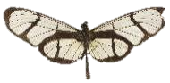






Study system: Neotropical butterflies
Ithomiini tribe
Heliconiini tribe
Mimicry
Phylogeny
Range
Habitat/Diet
Credit photos: N. Chazot
Credit photos: C. Jiggins
Maël Doré – SFE² - GfÖ - EEF – 2022
5

Slide 15
Study system: Neotropical butterflies
Ithomiini tribe
Heliconiini tribe
Mimicry
Phylogeny
Range
Habitat/Diet
Credit photos: N. Chazot
Credit photos: C. Jiggins
Maël Doré – SFE² - GfÖ - EEF – 2022
5

Slide 16
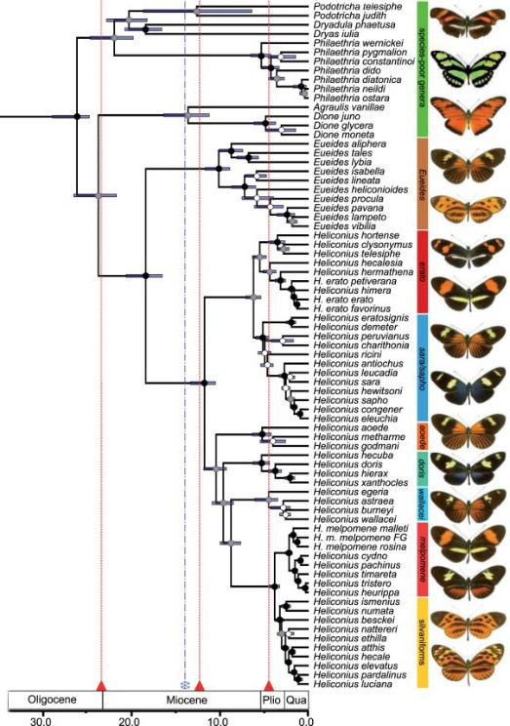
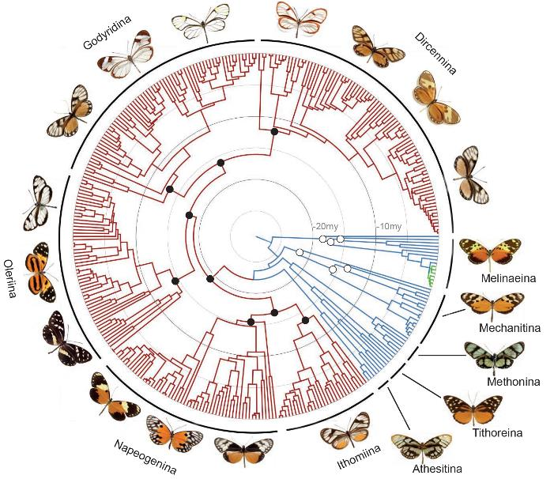
Study system: Neotropical butterflies
Ithomiini tribe
Heliconiini tribe
Mimicry
Phylogeny
Range
Habitat/Diet
Crown age ≈
26 My
Crown age ≈
26 My
Chazot et al., 2019
Kozak et al., 2015
Maël Doré – SFE² - GfÖ - EEF – 2022
6

Slide 17
Study system: Neotropical butterflies
Ithomiini tribe
Heliconiini tribe
Mimicry
Phylogeny
Range
Habitat/Diet
Crown age ≈
26 My
Crown age ≈
26 My
MRCA ≈ 84.6 My
Chazot et al., 2019
Kozak et al., 2015
Maël Doré – SFE² - GfÖ - EEF – 2022
6

Slide 18
Study system: Neotropical butterflies
Ithomiini tribe
Heliconiini tribe
48 genera
396 species
1511 subsp.
Mimicry
Phylogeny
Range
Habitat/Diet
8 genera
77 species
463 subsp.
Chazot et al., 2019
Kozak et al., 2015
Maël Doré – SFE² - GfÖ - EEF – 2022
6

Slide 19
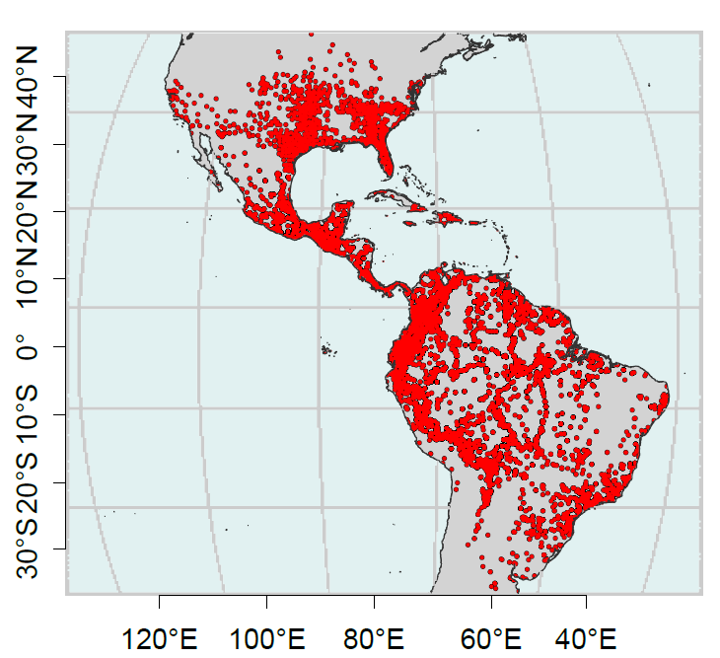
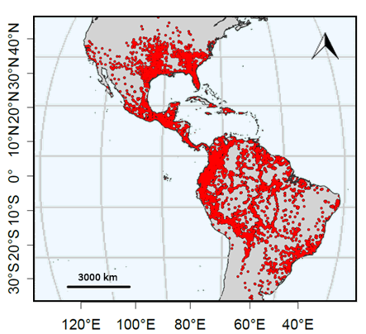
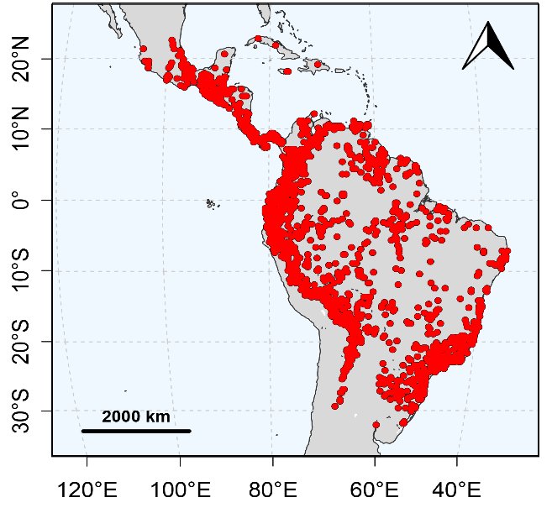
Study system: Neotropical butterflies
Ithomiini tribe
Heliconiini tribe
Occurrence map
Occurrence map
Mimicry
Phylogeny
Range
Habitat/Diet
Occurrences
Occurrences
Doré et al., 2021
Perochon et al., in prep
Maël Doré – SFE² - GfÖ - EEF – 2022
7

Slide 20
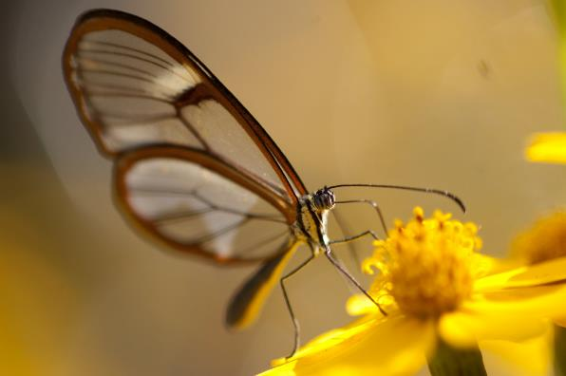
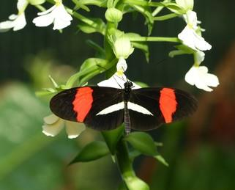
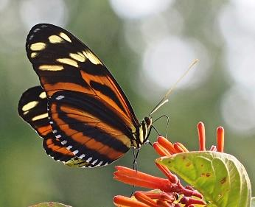
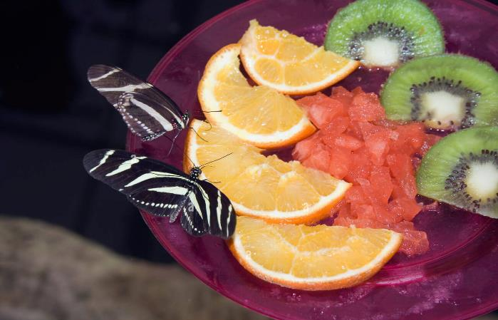
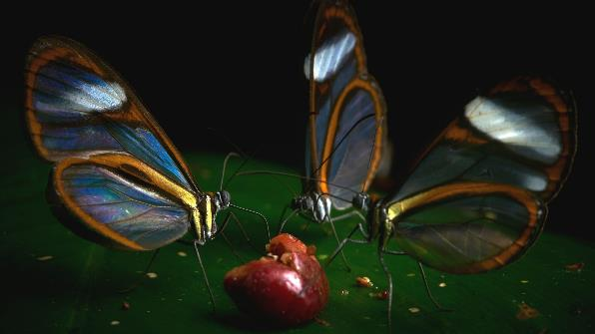
Study system: Neotropical butterflies
Ithomiini tribe
Heliconiini tribe
Credit photo: E. Zamora
Mimicry
Phylogeny
Range
Habitat/Diet
Credit photo: M. Miłaszewska
Credit photo: A.R. Villaseñor
Credit photo: P. Bretner
Credit photo: Hilary Morgan
Maël Doré – SFE² - GfÖ - EEF – 2022
8

Slide 21
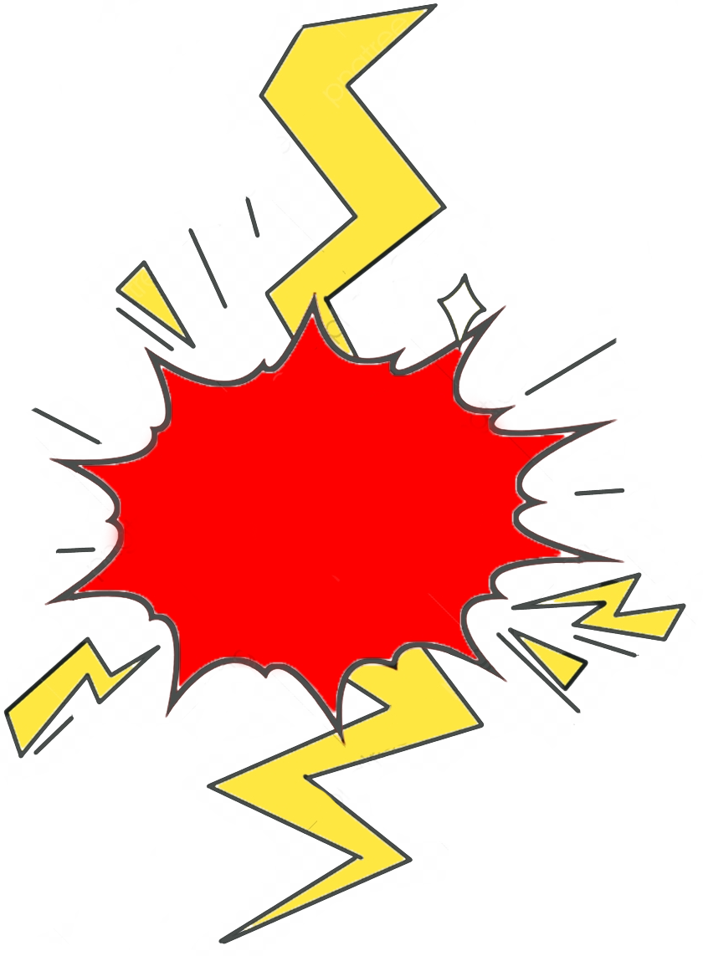
Study system: Neotropical butterflies
Ithomiini tribe
Heliconiini tribe
Credit photo: E. Zamora
Mimicry
Phylogeny
Range
Habitat/Diet
Credit photo: M. Miłaszewska
Credit photo: A.R. Villaseñor
Competition
Credit photo: P. Bretner
Credit photo: Hilary Morgan
Maël Doré – SFE² - GfÖ - EEF – 2022
8

Slide 22
Objectives
Can mutualistic interactions outweigh the effects of competition at the macroecological scale?
Biodiversity patterns: Are large-scale biodiversity patterns different between tribes?
1
Spatial congruence: Do phenotypically similar species cooccur more than expected at random?
2
Niche similarity: Do phenotypically similar species have similar climatic niche?
3
Niche convergence: Is the climatic niche of phenotypically similar species more similar than expected from shared ancestry?
4
Maël Doré – SFE² - GfÖ - EEF – 2022
9

Slide 23
Biodiversity patterns
SDM Species distribution maps Diversity indices
Maël Doré – SFE² - GfÖ - EEF – 2022
10

Slide 24
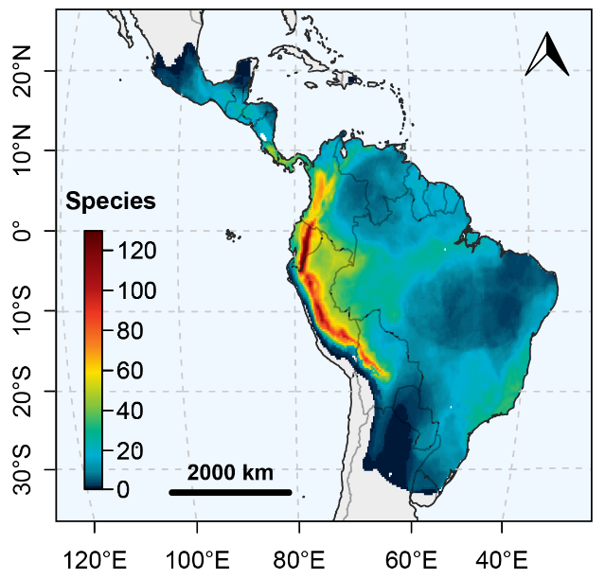
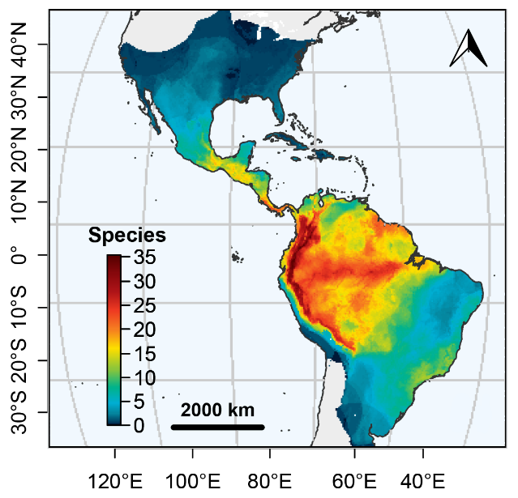
Biodiversity patterns
Species richness
Ithomiini
Heliconiini
Doré et al., 2021
Pérochon et al., in prep
Maël Doré – SFE² - GfÖ - EEF – 2022
11

Slide 25
Objectives
Can mutualistic interactions outweigh the effects of competition at the macroecological scale?
Biodiversity patterns: Are large-scale biodiversity patterns different between tribes?
1
Spatial congruence: Do phenotypically similar species cooccur more than expected at random?
2
Niche similarity: Do phenotypically similar species have similar climatic niche?
3
Niche convergence: Is the climatic niche of phenotypically similar species more similar than expected from shared ancestry?
4
Maël Doré – SFE² - GfÖ - EEF – 2022
12

Slide 26
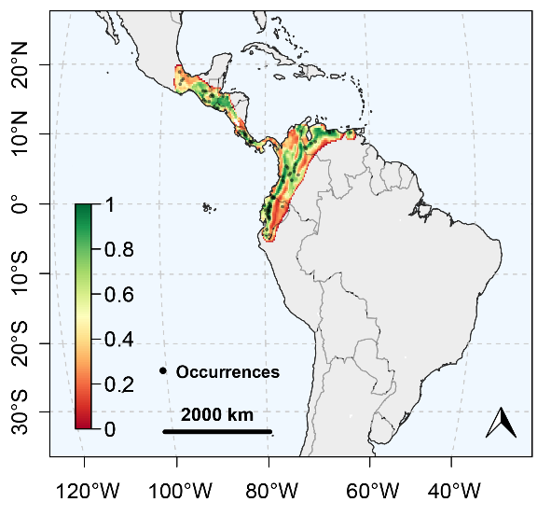
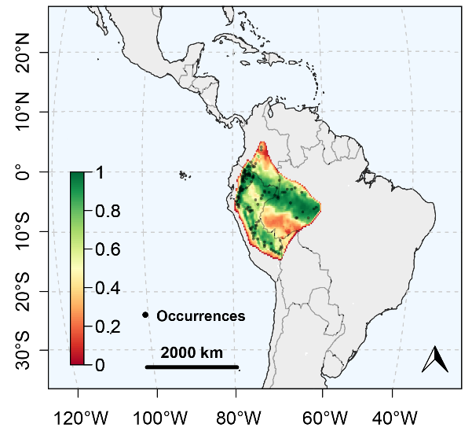


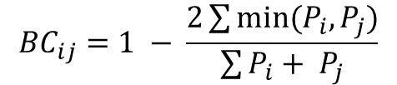
Spatial congruence
Question: Do phenotypically similar species cooccur more than expected at random?
Hypothesis: Lower spatial dissimilarity for comimetic species
$${BC}_{ij}=1 − \frac{2\sum{min⁡(P_{i},P_{j})}}{\sum{P_{i}+ P_{j}}}$$
Dircenna jemina (DILUCIDA)
Mechanitis mazaeus (MAELUS)
P(presence)
No mimicry
P(presence)
BC = 0.9
Maël Doré – SFE² - GfÖ - EEF – 2022
13

Slide 27
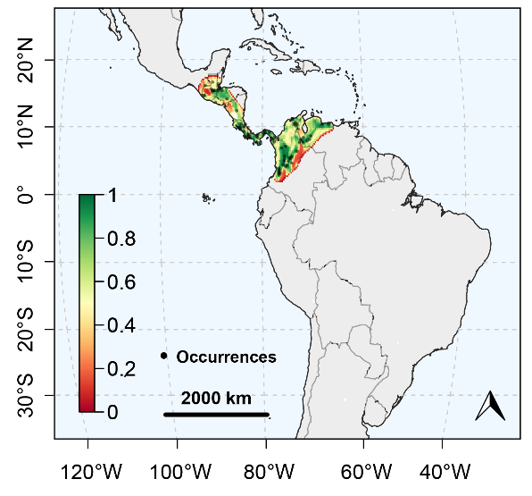

Spatial congruence
Question: Do phenotypically similar species cooccur more than expected at random?
Hypothesis: Lower spatial dissimilarity for comimetic species
$${BC}_{ij}=1 − \frac{2\sum{min⁡(P_{i},P_{j})}}{\sum{P_{i}+ P_{j}}}$$
Dircenna jemina (DILUCIDA)
Dircenna dero (DILUCIDA)
P(presence)
Mimicry
P(presence)
BC = 0.2
Maël Doré – SFE² - GfÖ - EEF – 2022
14

Slide 28

Spatial congruence
Question: Do phenotypically similar species cooccur more than expected at random?
Global: Mean BC_{obs} << Mean BC_{perm}
Per ring: Significant for 85% of rings in Ithomiini
Non-significant rings = low N
Results: Mimicry promotes the spatial congruence of phenotypically similar species at large-scale
Next: What happens between tribes?
Maël Doré – SFE² - GfÖ - EEF – 2022
15

Slide 29
Spatial congruence
Question: Do phenotypically similar species cooccur more than expected at random?
Global: Mean BC_{obs} << Mean BC_{perm}
Per ring: Significant for 85% of putative rings
Non-significant rings = low N
Results: Mimicry promotes the spatial congruence of phenotypically similar species at large-scale
Next: What happens between tribes?
Maël Doré – SFE² - GfÖ - EEF – 2022
15

Slide 30
Spatial congruence
Question: Do phenotypically similar species cooccur more than expected at random?
Global: Mean BC_{obs} << Mean BC_{perm}
Per ring: Significant for 85% of putative rings
Non-significant rings = low N
Results: Mimicry promotes the spatial congruence of phenotypically similar species at large-scale
Next: What happens between tribes?
Maël Doré – SFE² - GfÖ - EEF – 2022
15

Slide 31
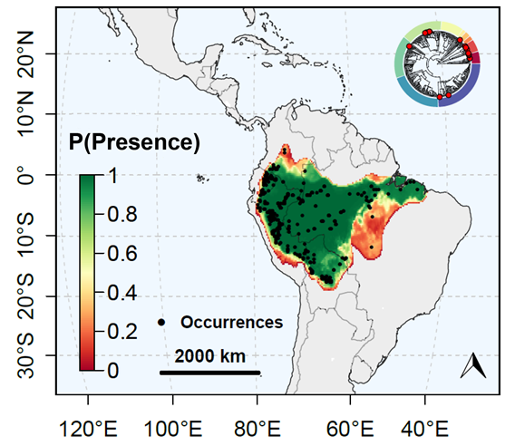
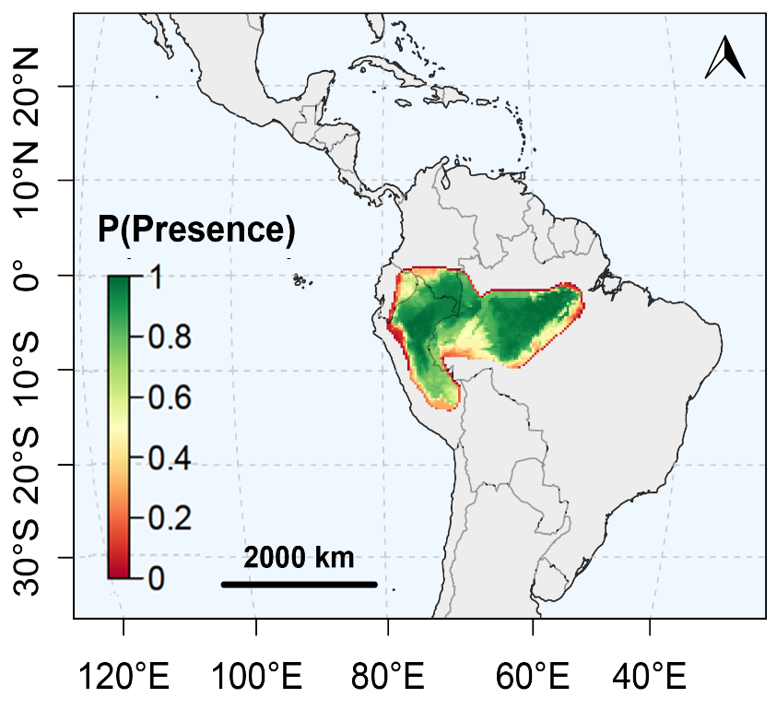
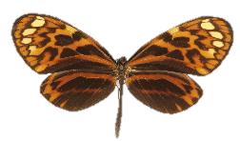

Spatial congruence
Ithomiini: pattern MAELUS
(16 species)
Heliconiini: pattern MAELUS
(2 species)
Maël Doré – SFE² - GfÖ - EEF – 2022
16

Slide 32
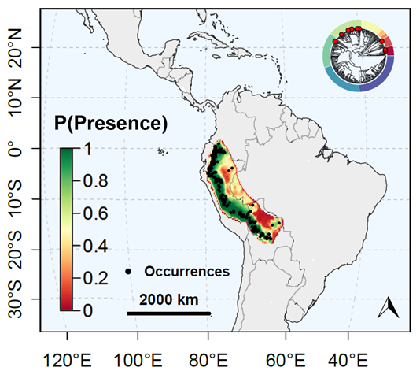
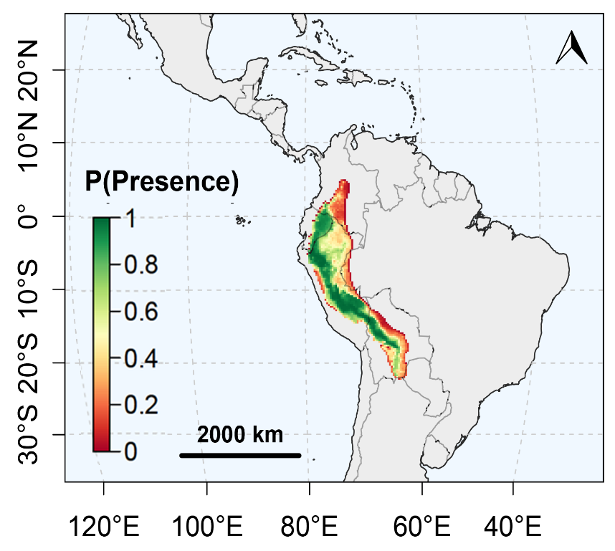
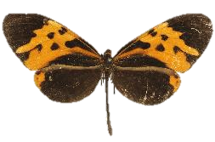

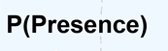
Spatial congruence
Ithomiini: pattern MOTHONE
(14 species)
Heliconiini: pattern MOTHONE
(3 species)
Maël Doré – SFE² - GfÖ - EEF – 2022
17

Slide 33
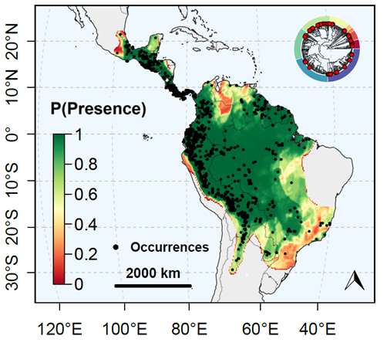
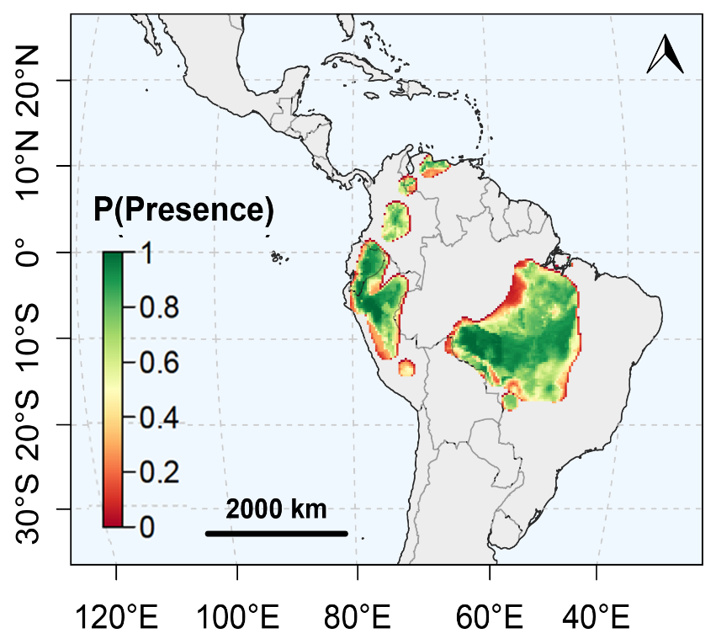
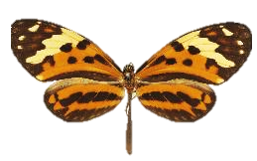

Spatial congruence
Ithomiini: pattern MAMERCUS
(64 species)
Heliconiini: pattern MAMERCUS
(4 species)
Maël Doré – SFE² - GfÖ - EEF – 2022
18

Slide 34
Objectives
Can mutualistic interactions outweigh the effects of competition at the macroecological scale?
Biodiversity patterns: Are large-scale biodiversity patterns different between tribes?
1
Spatial congruence: Do phenotypically similar species cooccur more than expected at random?
2
Niche similarity: Do phenotypically similar species have similar climatic niche?
3
Niche convergence: Is the climatic niche of phenotypically similar species more similar than expected from shared ancestry?
4
Maël Doré – SFE² - GfÖ - EEF – 2022
19

Slide 35
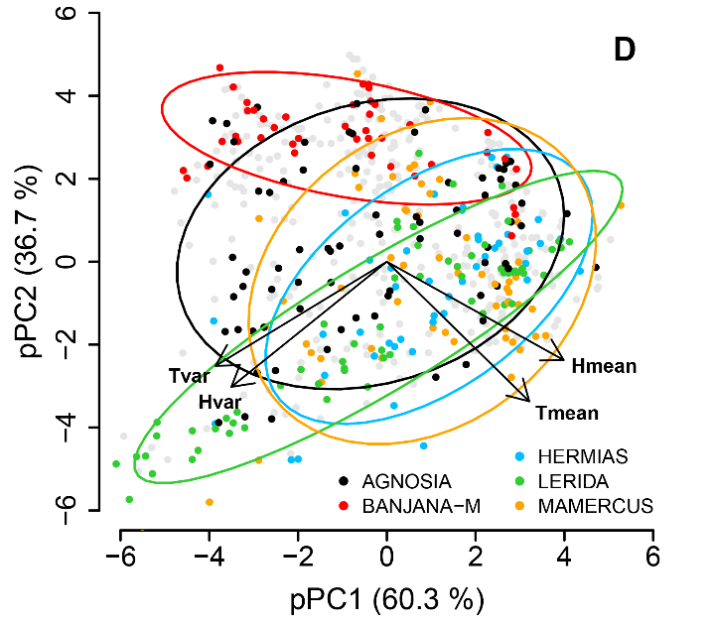
Climatic niche similarity
Question: Do mimicry rings occupy different climatic niche?
Global: perMANOVA, R² = 0.41, p = 0.001
Per ring:
81.0% pairs with p < 0.05
66.4% pairs with p < 0.001
Next: Is this pattern due to shared ancestry or evolutionary convergence?
Maël Doré – SFE² - GfÖ - EEF – 2022
20

Slide 36
Climatic niche similarity
Question: Do mimicry rings occupy different climatic niche?
Global: perMANOVA, R² = 0.41, p = 0.001
Per ring:
81.0% pairs with p < 0.05
66.4% pairs with p < 0.001
Next: Is this pattern due to shared ancestry or evolutionary convergence?
Maël Doré – SFE² - GfÖ - EEF – 2022
20

Slide 37
Climatic niche similarity
Question: Do mimicry rings occupy different climatic niche?
Global: perMANOVA, R² = 0.41, p = 0.001
Per ring:
81.0% pairs with p < 0.05
66.4% pairs with p < 0.001
Next: Is this pattern due to shared ancestry or evolutionary convergence?
Maël Doré – SFE² - GfÖ - EEF – 2022
20

Slide 38
Objectives
Can mutualistic interactions outweigh the effects of competition at the macroecological scale?
Biodiversity patterns: Are large-scale biodiversity patterns different between tribes?
1
Spatial congruence: Do phenotypically similar species cooccur more than expected at random?
2
Niche similarity: Do phenotypically similar species have similar climatic niche?
3
Niche convergence: Is the climatic niche of phenotypically similar species more similar than expected from shared ancestry?
4
Maël Doré – SFE² - GfÖ - EEF – 2022
21

Slide 39
Climatic niche evolution
Question: Is this pattern due to shared ancestry or evolutionary convergence?
Maël Doré – SFE² - GfÖ - EEF – 2022
22

Slide 40
Climatic niche evolution
Question: Is this pattern due to shared ancestry or evolutionary convergence?
Maël Doré – SFE² - GfÖ - EEF – 2022
23

Slide 41
Climatic niche evolution
Question: Is the climatic niche of phenotypically similar species more similar than expected from the phylogeny?
Simulate the evolution of climatic niche under multivariate neutral evolutionary model
phyloMANOVA: λ_{obs} << λ_{simul}
Conclusion:
Evolutionary association between climatic niche and mimicry patterns
Strengthens cooccurrence of phenotypically similar species
Maël Doré – SFE² - GfÖ - EEF – 2022
24

Slide 42
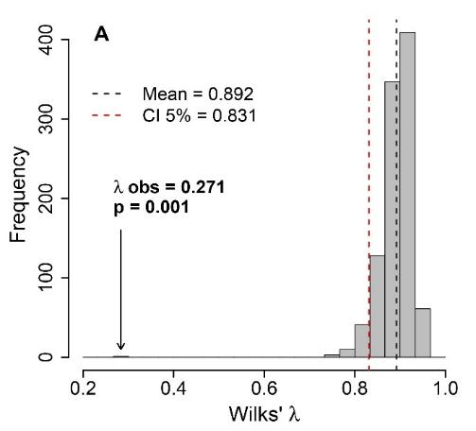
Climatic niche evolution
Question: Is the climatic niche of phenotypically similar species more similar than expected from the phylogeny?
Simulate the evolution of climatic niche under multivariate neutral evolutionary model
phyloMANOVA: λ_{obs} << λ_{simul}
Conclusion:
Evolutionary association between climatic niche and mimicry patterns
Strengthens cooccurrence of phenotypically similar species
Maël Doré – SFE² - GfÖ - EEF – 2022
24

Slide 43
Climatic niche evolution
Question: Is the climatic niche of phenotypically similar species more similar than expected from the phylogeny?
Simulate the evolution of climatic niche under multivariate neutral evolutionary model
phyloMANOVA: λ_{obs} << λ_{simul}
Conclusion:
Evolutionary association between climatic niche and mimicry patterns
Strengthens large-scale spatial congruence of phenotypically similar species
Maël Doré – SFE² - GfÖ - EEF – 2022
24

Slide 44



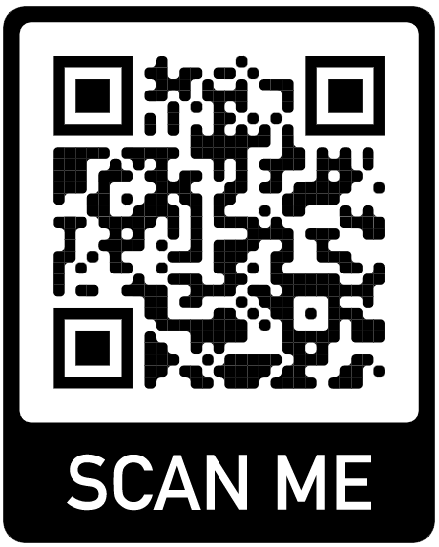







Research team
Advisors: Marianne Elias (ISYEB) & Colin Fontaine (CESCO)
Funding: PhD Grant (French MESR) & Marianne Elias (HFSP Grant)
Main collaborators:
Eddie Pérochon, Université de Lausanne, Switzerland
Keith Willmott, Florida University, USA
Andre Freitas, Campinas State University, Brazil
Nicolas Chazot, SUAS, Sweden
Sébastien Lavergne, LECA, France
Neil Rosser, Harvard University, USA
Krzysztof Kozak, STRI, Panama
Sébastien Lavergne
MaelDore
Mael_Dore
Maël Doré – SFE² - GfÖ - EEF – 2022
25

Slide 45
References
Chazot, N., Willmott, K. R., Lamas, G., Freitas, A. V. L., Piron-Prunier, F., Arias, C. F., Mallet, J., De-Silva, D. L., & Elias, M. (2019). Renewed diversification following Miocene landscape turnover in a Neotropical butterfly radiation. Global Ecology and Biogeography, 28(8), 1118–1132. https://doi.org/10.1111/geb.12919
Doré, M., Willmott, K., Leroy, B., Chazot, N., Mallet, J., Freitas, A. V., ... & Elias, M. (2022). Anthropogenic pressures coincide with Neotropical biodiversity hotspots in a flagship butterfly group. Diversity and Distributions. https://doi.org/10.1111/ddi.13455
Kozak, K. M., Wahlberg, N., Neild, A. F., Dasmahapatra, K. K., Mallet, J., & Jiggins, C. D. (2015). Multilocus species trees show the recent adaptive radiation of the mimetic Heliconius butterflies. Systematic biology, 64(3), 505-524. https://doi.org/10.1093/sysbio/syv007
Müller, F. (1879). Ituna and Thyridia; a remarkable case of mimicry in butterflies. Trans. Entomol. Soc. Lond., xx–xxix.
Pérochon, E., Rosser, N., Kozak, K. M., Willmott, K., Elias, M. & Doré M. (in prep.). Müllerian mimicry as a driver for congruence of geographic distribution drivers in two distant Neotropical butterfly tribes.
Maël Doré – SFE² - GfÖ - EEF – 2022
26

